Slide 1
Multiscale RNNs
May 17
Renjie Qian

Slide 2
Paper List
Koutník, J., Greff, K., Gomez, F., Schmidhuber, J. (2014), A Clockwork RNN, in ICML 2014, Beijing, China.
B. Oliva, J., Poczos, B., Schneider, J. (2017), The Statistical Recurrent Unit, in ICML 2017, Sydney, Australia.
Mujika, A., Meier, F., Steger, A. (2017), Fast-Slow Recurrent Neural Networks, in NIPS 2017, Long Beach, CA, USA.

Slide 3
Contents
Clockwork RNN (CW-RNN)
Statistical Recurrent Unit (SRU)
Fast-Slow RNN (FS-RNN)

Slide 4
The Basic Motivation of Multiscale RNNs
(Long-term dependency) By adding slowly updated units/layers, the architecture is hoped to memory long-term information.
(More flexible to extract information) With various updating frequency units/layers, the model can extract historical information at different time scales. It can exploit a fund of information.
(Efficient computation & better gradient flow) Slowly updated units/layers can largely ease computation and improve gradient flow.

Slide 5
PART 1 Clockwork RNN
Clockwork RNN was proposed by Koutník et. al (2014). It can be seemed as a multiscale modification of the simple RNN.
A clockwork RNN has various recurrent modules updated at various fixed frequency, like a clock has hour hand, minute hand and second hand.

Slide 6
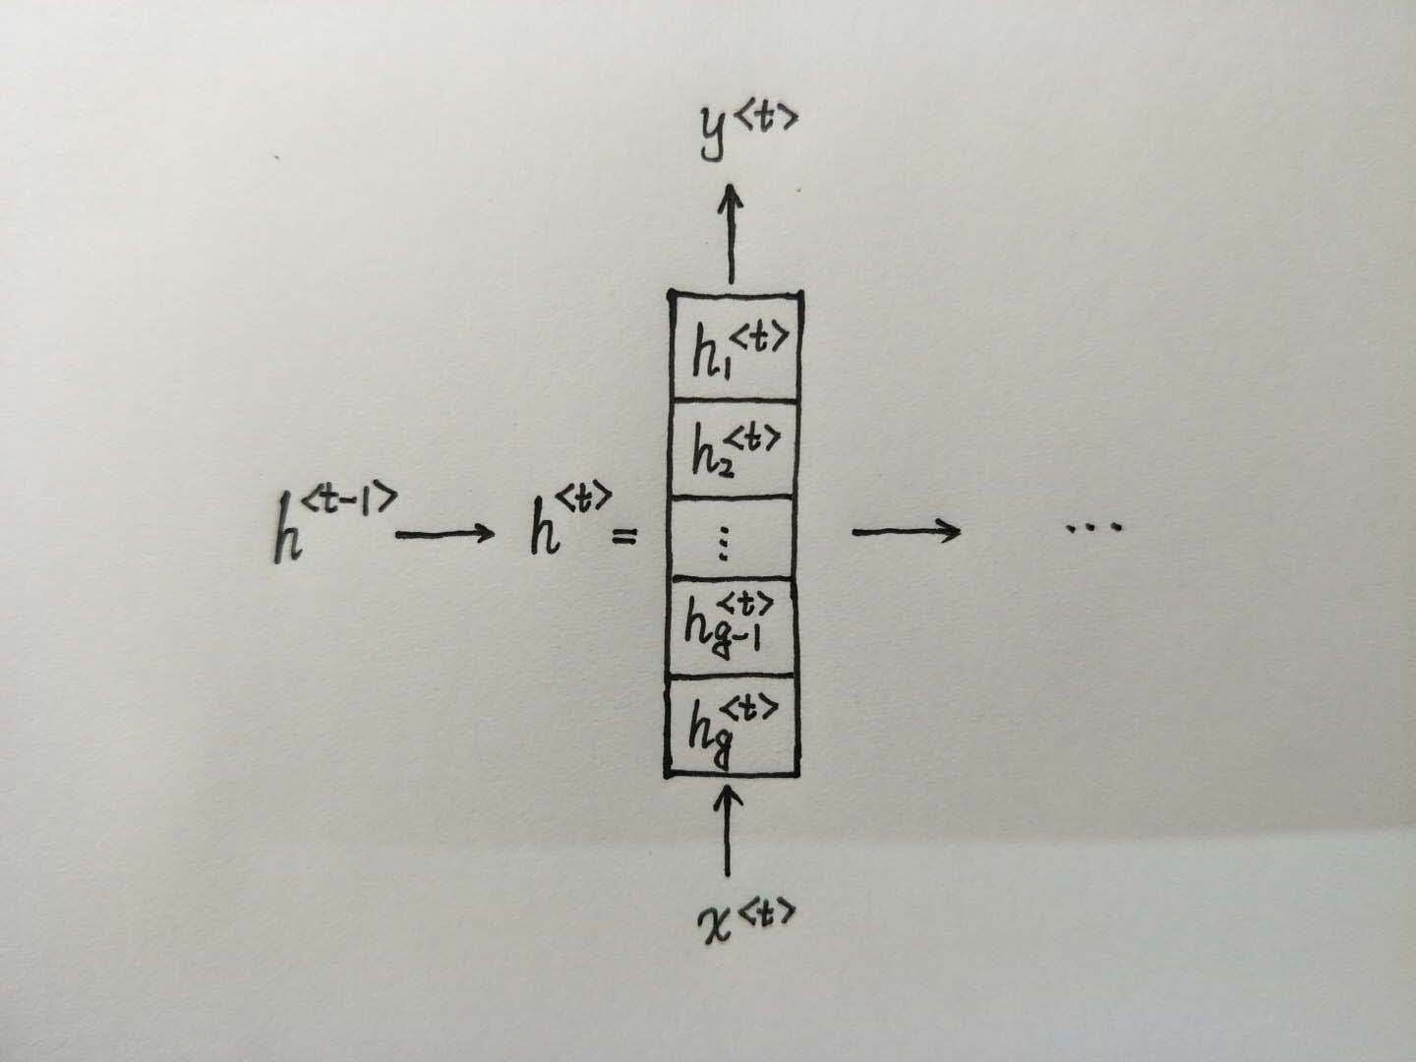

Model Architecture
Clock periods $T_{1}, T_{2}, ⋯, T_{g}$. In the paper, the authors use the exponential series of periods: module $i$ has clock period $T_{i}=2^{i−1}$.

Slide 7
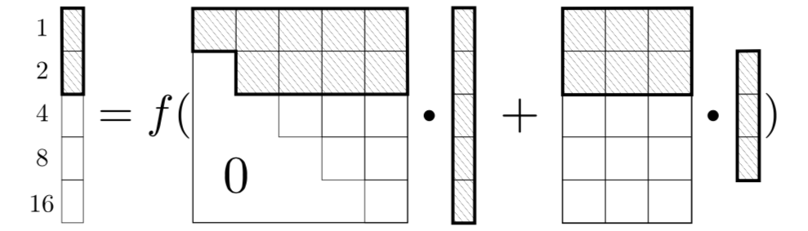






Update Rule
Only modules with slow updating frequency can effect modules with faster updating frequency. Thus the matrix $W_{h}$ is block upper triangular.
At time step $t$, only module $h_{i}^{<t>}$ with clock period $T_{i}$ such that $t mod T_{i}=0$ is updated. Other modules are unchanged.
Example ($T_{1}=1, T_{2}=2, ⋯, T_{5}=16$, time step $t$= 6)
$$h^{<t>}$$
$$W_{h}$$
$$h^{<t−1>}$$
$$W_{x}$$
$$x^{<t>}$$

Slide 8
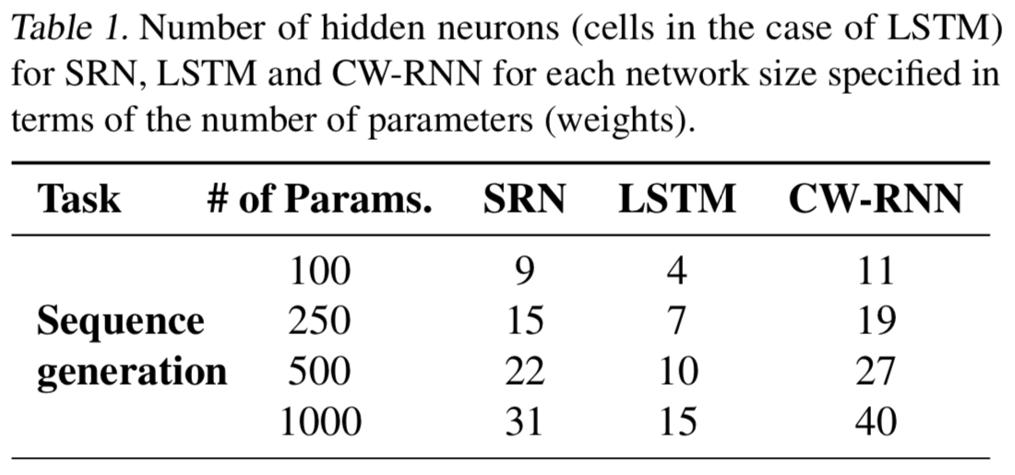
Experiment
Sequence generation task
No input, output desired sequences (a piece of music at 44.1Hz for 7ms)
2000 epochs. Momentum coefficient = 0.95. Learning rate = 3e-4 for SRN & CW-RNN, 3e-5 for LSTM.
Modules’ time periods are 1, 2, 4, …, 256 in CW-RNN
Each network type was run with 4 different sizes:100, 250, 500 and1000 parameters

Slide 9
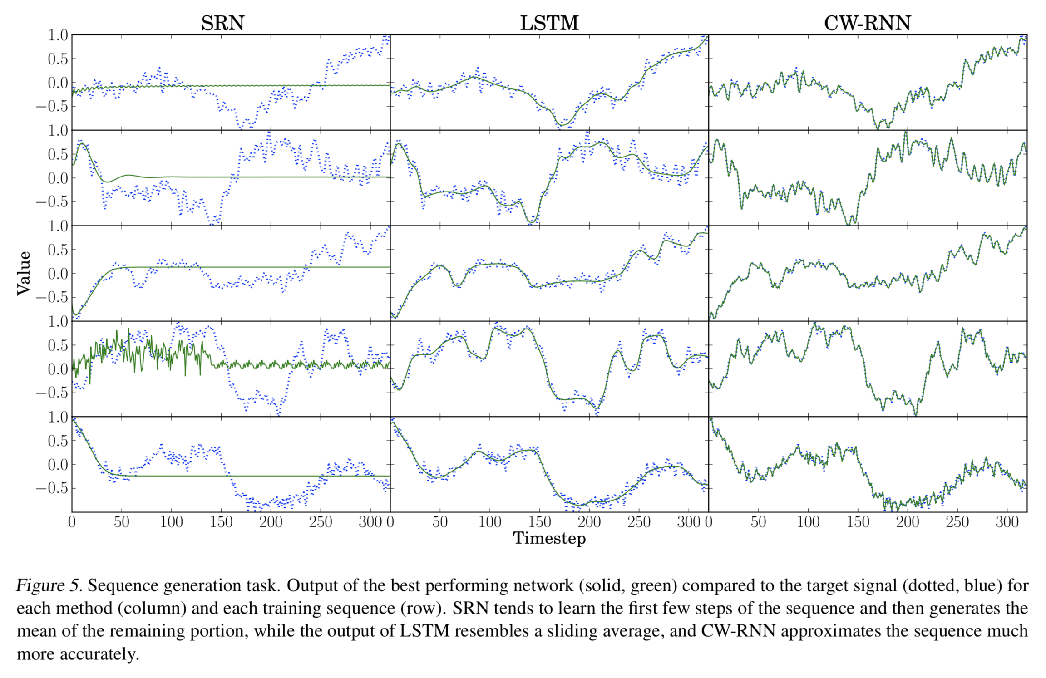

Slide 10
PART 2 Statistical Recurrent Unit
The statistical Recurrent Unit was proposed by Oliva et. al (2017).
The motivation to use statistics in tasks is to extract the useful information in piles of data and throw the useless one away.
Oliva et. al (2017) wondered why not use statistics in RNN to memory the historical information? Smoothing statistics by exponential moving average can give different attention to the information at different timesteps. Then linearly combining them can give more attention to some particular timesteps you care more about in the past.

Slide 11
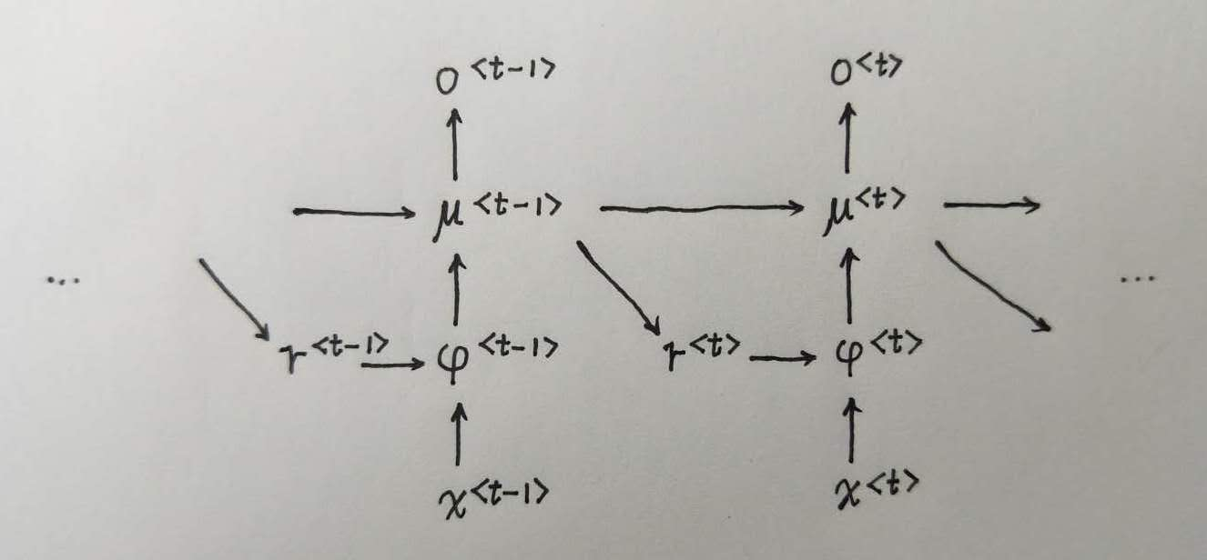

Model Architecture
In the model, $φ^{<t>}$ is the statistic, $μ^{<t>}$ is the exponential moving average of them, and $r^{<t>}$ can be seemed as a re-representation of historical information.

Slide 12
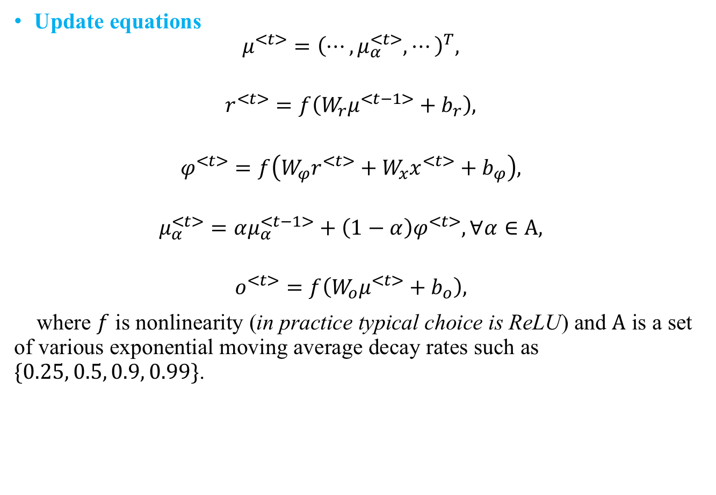
Update equations
$$μ^{<t>}={\left(⋯,μ_{α}^{<t>}, ⋯\right)}^{T},$$
$$r^{<t>}=f\left(W_{r}μ^{<t−1>}+b_{r}\right),$$
$$φ^{<t>}=f\left(W_{φ}r^{<t>}+W_{x}x^{<t>}+b_{φ}\right),$$
$$μ_{α}^{<t>}=αμ_{α}^{<t−1>}+\left(1−α\right)φ^{<t>}, ∀α∈Α,$$
$$o^{<t>}=f\left(W_{o}μ^{<t>}+b_{o}\right),$$
where $f$ is nonlinearity (in practice typical choice is ReLU) and $Α$ is a set of various exponential moving average decay rates such as $\{0.25, 0.5, 0.9, 0.99\}$.

Slide 13
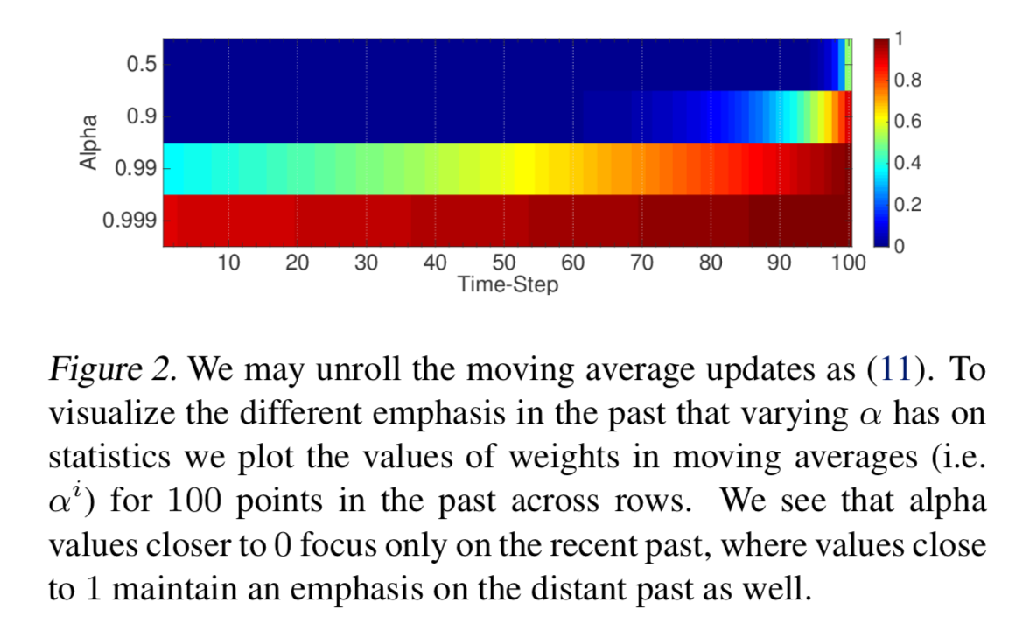

The Information Compressed in Moving Average Statistics
Exponential moving average
It is easy to see the decomposition,
$$μ_{α}^{<t>}=(1−α)(φ^{<t>}+αφ^{<t−1>}+α^{2}φ^{<t−2>}+⋯)$$
Smaller $α$ gives more attention to the recent past, while larger $α$ cares past more

Slide 14
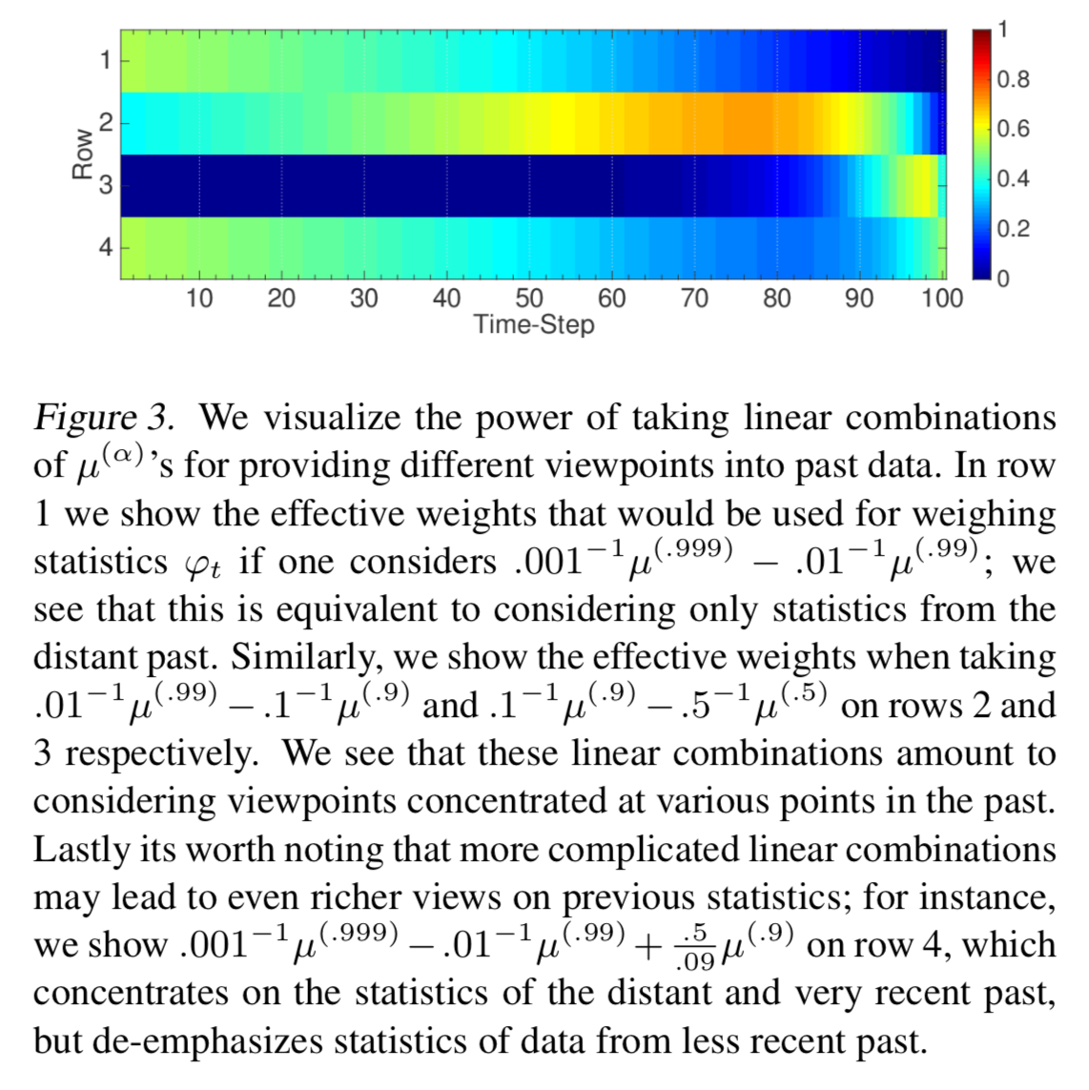
Linear combination of exponential moving average

Slide 15
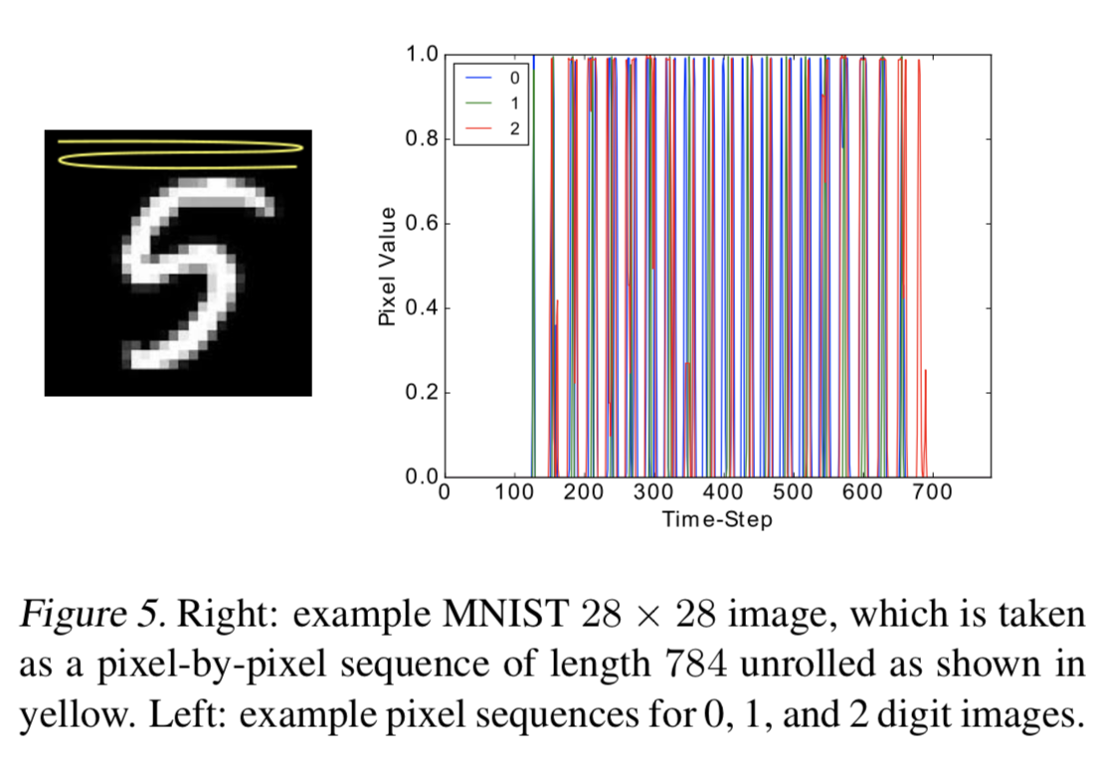
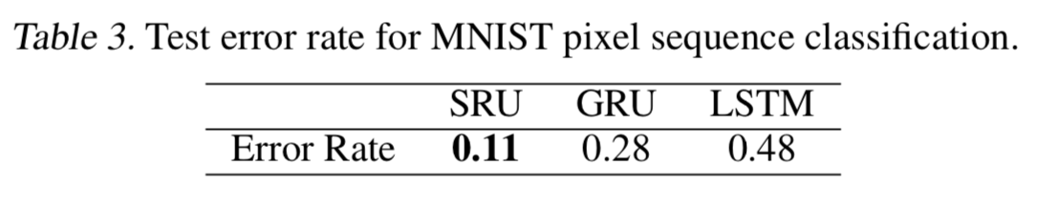

Experiments
MNIST Image Classification
Change $28×28$ gray-scale digit image into a flattened sequence $\{x_{1},⋯, x_{784}\}$
Compared with LSTM & GRU

Slide 16
PART 3 Fast-Slow RNN
Fast-Slow RNN was proposed by Mujika et. al (2017). As the authors described, it incorporates the strengths of both multiscale RNNs and deep transition RNNs.

Slide 17
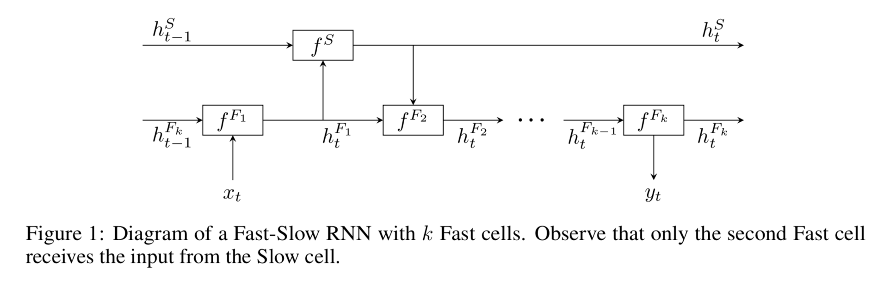

Architecture
The architecture of Fast-Slow RNN is quite simple. It consists of sequentially connected RNN cells in the lower hierarchical layer and one RNN cell in the higher hierarchical layers.
The building block in the architecture can be any RNN unit, e. g. LSTM.
Update equations
$$h_{t}^{F_{1}}=f^{F_{1}}\left(h_{t−1}^{F_{k}}, x_{t}\right),$$
$$h_{t}^{S}=f^{S}\left(h_{t−1}^{S}, h_{t}^{F_{1}}\right),$$
$$h_{t}^{F_{2}}=f^{F_{2}}\left(h_{t}^{F_{1}}, h_{t}^{S}\right),$$
$$h_{t}^{F_{i}}=f^{F_{i}}\left(h_{t}^{F_{i−1}}\right), i=3, ⋯,k.$$

Slide 18
Experiments
Task: predict the probability distribution of the next character given all the previous ones.
Dataset
Penn Treebank: The dataset is a collection of Wall Street Journal articles written in English. It only contains10000different words, all written in lower-case, and rare words are replaced with"<unk>". The dataset is split into train, validation and test sets consisting of 5.1M,400K and450K characters, respectively.
Hutter Prize Wikipedia: This dataset is also known asenwik8and it consists of "raw” Wikipedia data, that is, English articles, tables, XML data, hyperlinks and special characters. The data set contains100M characters with205unique tokens. The dataset is split into train, validation and test sets consisting of90M,5M and5M characters, respectively.
Implementation details:
Minimize cross-entropy
Evaluate by BPC measure
Adam optimizer
Dropout
Gradient norm normalization
Initialization: bias = 1, matrix = orthogonal matrix

Slide 19
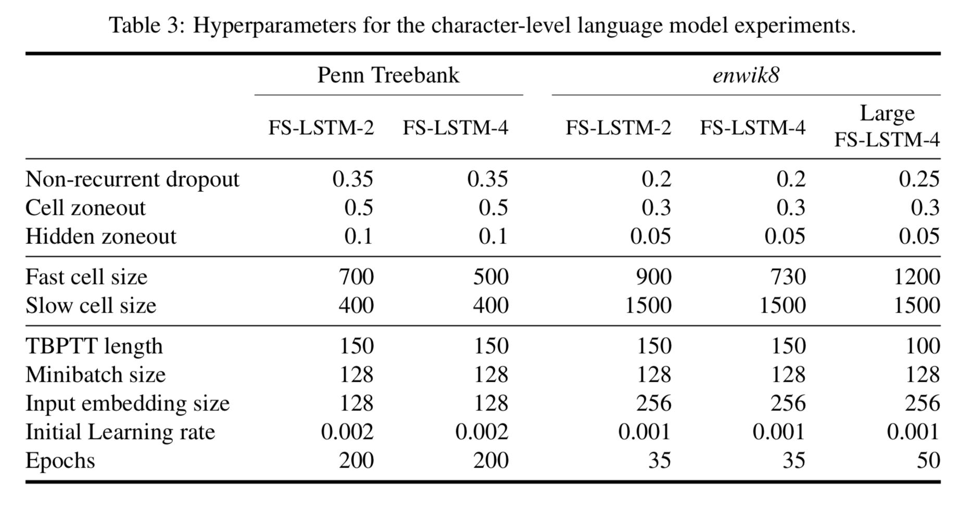

Slide 20
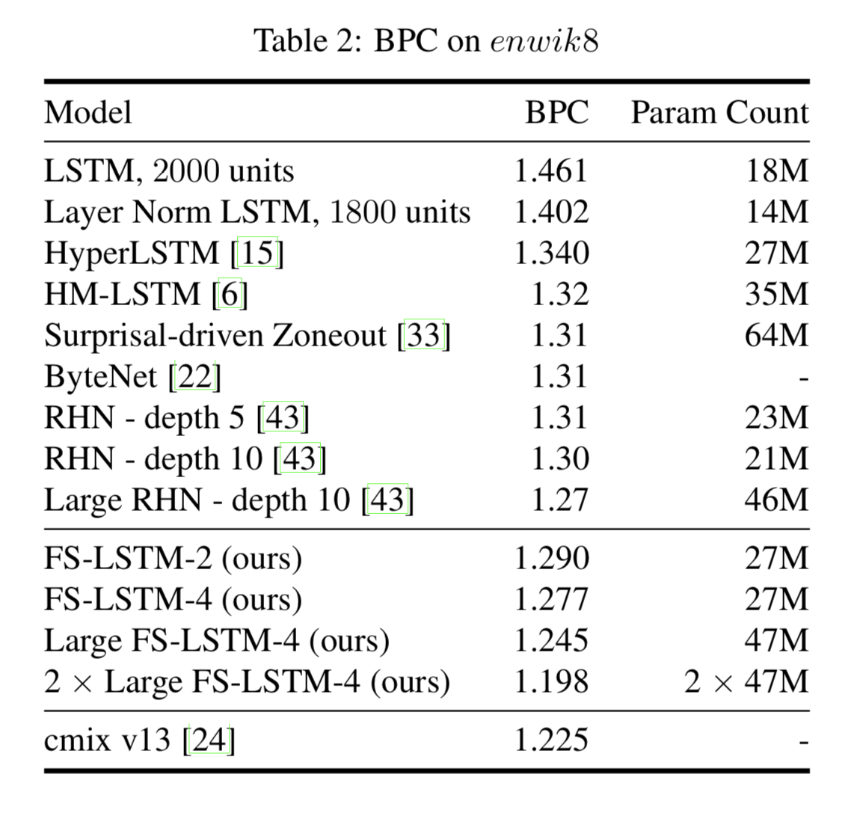
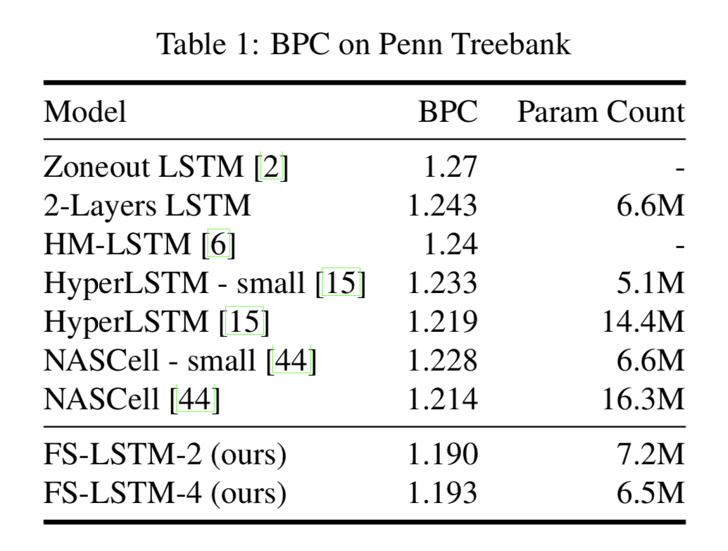
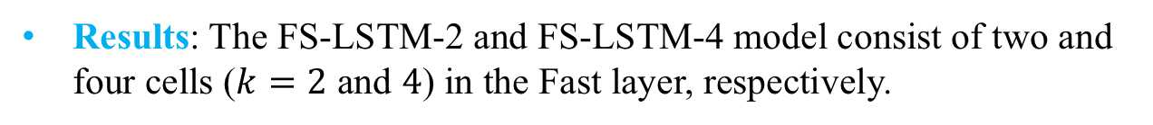
Results: The FS-LSTM-2 and FS-LSTM-4 model consist of two and four cells ($k=2$ and $4$) in the Fast layer, respectively.

Slide 21
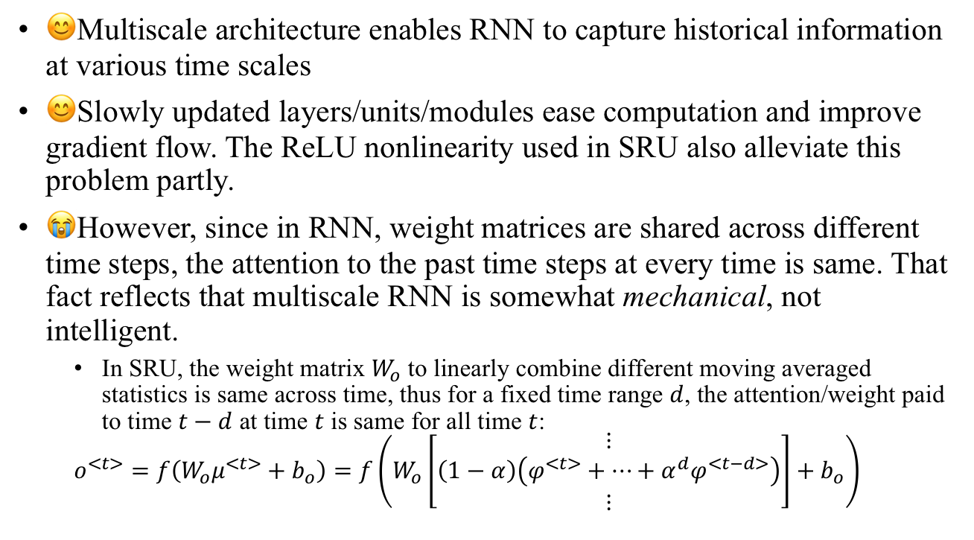
Summary
😊Multiscale architecture enables RNN to capture historical information at various time scales
😊Slowly updated layers/units/modules ease computation and improve gradient flow. The ReLU nonlinearity used in SRU also alleviate this problem partly.
😭However, since in RNN, weight matrices are shared across different time steps, the attention to the past time steps at every time is same. That fact reflects that multiscale RNN is somewhat mechanical, not intelligent.
In SRU, the weight matrix $W_{o}$ to linearly combine different moving averaged statistics is same across time, thus for a fixed time range $d$, the attention/weight paid to time $t−d$ at time $t$ is same for all time $t$:
$$o^{<t>}=f\left(W_{o}μ^{<t>}+b_{o}\right)=f\left(W_{o}\left[\begin{matrix}⋮ \\ \left(1−α\right)\left(φ^{<t>}+⋯+α^{d}φ^{<t−d>}\right) \\ ⋮\end{matrix}\right]+b_{o}\right)$$

